Slide 1


APPLICATION CHEMISTRY
A2 LEVEL
ANALYTICAL CHEMISTRY
CHAPTER 5:
NUCLEAR MAGNETIC RESONANCE (NMR)

Slide 2

What you should know…

Slide 3
Magnetic Properties Of The Nucleus
Nuclei of hydrogen atoms spin about an axis.
This spin is associated with a circulation of electric charge.
Circulating charges give rise to magnetic fields, so the spinning ¹H nucleus has a magnetic moment
When put in an external magnetic field the nuclei tend to turn to a preferred orientation in which the nuclear magnet is aligned with the external field

Slide 4
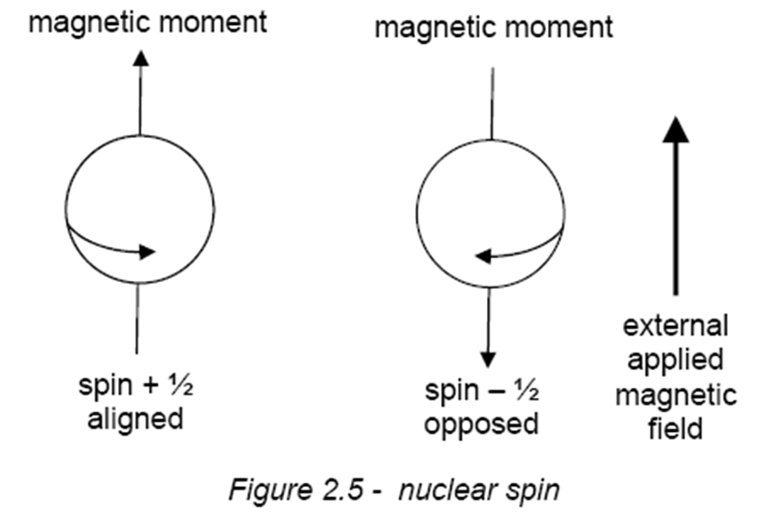
Magnetic Properties Of The Nucleus
Less favoured, orientation is when the nuclear magnet is aligned against (i.e. opposed to) the external field.
The only two orientations allowed for nuclei such as ¹H, which have a nuclear spin of ½ a unit

Slide 5
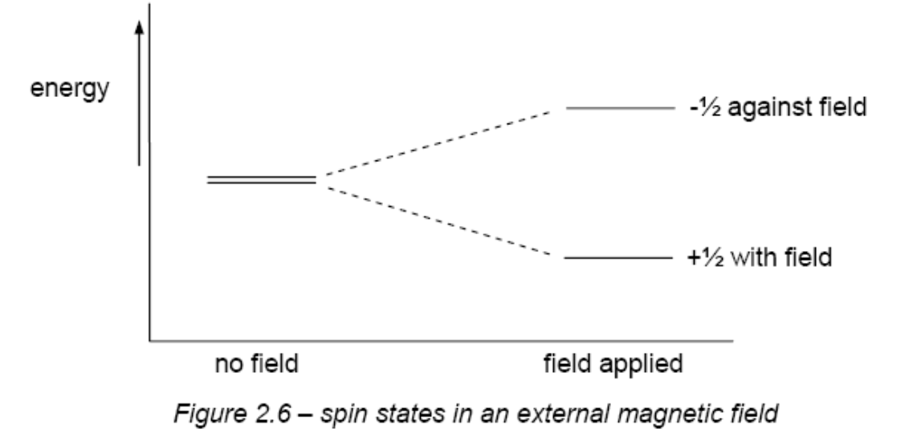
Magnetic Properties Of The Nucleus
In the absence of an applied field, the spin states of a given nucleus are of equal energy.
However, the spin states in an external magnetic field are no longer of equivalent energy and the two spin states occupy two different energy levels.

Slide 6
Magnetic Properties Of The Nucleus
The phenomenon of nuclear magnetic resonance occurs when nuclei aligned with the applied field absorb energy (ΔE in Figure 2.6) and change their spin orientation with respect to the field.
Energy difference between the two spin states is related to the frequency of electromagnetic radiation by the Planck equation:
energy absorbed = ΔE = hf

Slide 7
Magnetic Properties Of The Nucleus
Energy gap separating the two levels increases as the strength of the external field increases.
Because the energy gap, ΔE, is so small the two spin states are approximately equally populated.
The consequence of this is that the net absorption of radiation is very small, and so a very sensitive detection system is required.

Slide 8
The NMR spectrometer
A liquid sample is placed in a tube which spins in a magnetic field
Samples are dissolved in solvents which won’t affect the spectrum - CCl₄, CDCl₃, D₂O
TMS, tetramethylsilane, (CH₃)₄Si, is added to provide a reference signal
When the spectrum has been run, it can be integrated to find the relative peak areas
Spectrometers are now linked to computers to analyse data and store information

Slide 9
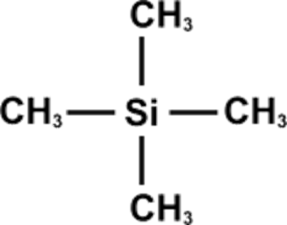
TETRAMETHYLSILANE - TMS
The position of all other signals is measured relative to TMS
The molecule contains four methyl groups attached to a silicon atom in a tetrahedral arrangement.
All the hydrogen atoms are chemically equivalent.

Slide 10
TETRAMETHYLSILANE - TMS
Provides the references signal
non-toxic liquid - SAFE TO USE
inert - DOESN’T REACT WITH COMPOUND BEING ANALYSED
has a low boiling point - CAN BE DISTILLED OFF AND USED AGAIN
all the hydrogen atoms are chemically equivalent - PRODUCES A SINGLE PEAK
twelve hydrogens so it produces an intense peak - DON’T NEED TO USE MUCH
signal is outside the range shown by most protons - WON’T OBSCURE MAIN SIGNALS
given the chemical shift of d = 0

Slide 11
The ¹H NMR spectra of organic compounds
Not all the ¹H atoms within a molecule absorb energy at the same frequency.
Frequency at which a proton absorbs radiation depends on the strength of the local magnetic field around it.
Even in a constant external field, protons in different chemical environments within a molecule absorb at different frequencies, because the local magnetic field they experience depends on the electrical and magnetic environment around them.

Slide 12
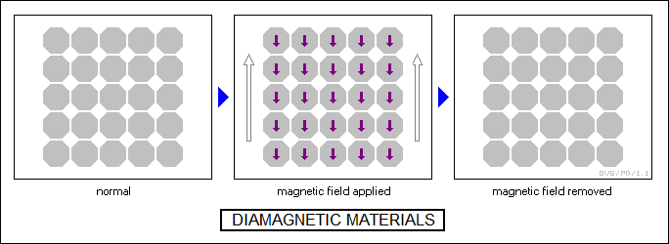
The ¹H NMR spectra of organic compounds
Electrons within molecules are usually ‘paired’ (i.e. they occur as pairs of electrons spinning in opposite directions).
When a molecule is placed in an external field, the electron pairs rotate in their orbits in such a way so that they produce a magnetic field which opposes the external field.
This phenomenon is called diamagnetism.

Slide 13
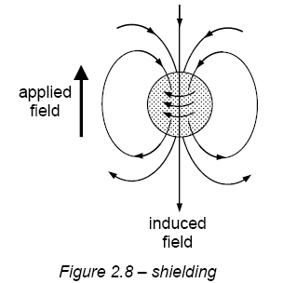
The ¹H NMR spectra of organic compounds
The effect is to ‘shield’ nearby protons from the external field.
This in turn reduces the frequency at which they absorb energy when they flip back from their lower to their higher energy state.

Slide 14
The ¹H NMR spectra of organic compounds
When a proton is near an electronegative atom within a molecule, the bonding electrons are drawn away from the proton to the electronegative atom.
The proton is less shielded from the external magnetic field, and hence it absorbs radiation at a higher frequency.
The effect is very pronounced if the proton is attached to a benzene ring.
In this situation the mobile delocalised π electrons in the ring can create a strong diamagnetic effect, opposing the external field.
This has the effect of strengthening the magnetic field within the vicinity of the protons

Slide 15
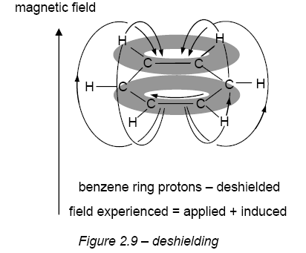
The ¹H NMR spectra of organic compounds

Slide 16
Chemical Shift
An NMR spectrum consists of a graph of absorbance against frequency.
The frequency scale is measured in units of chemical shift (symbol δ).
The chemical shift of a proton is the difference between its absorption frequency and that of TMS, measured in part per million (ppm).

Slide 17
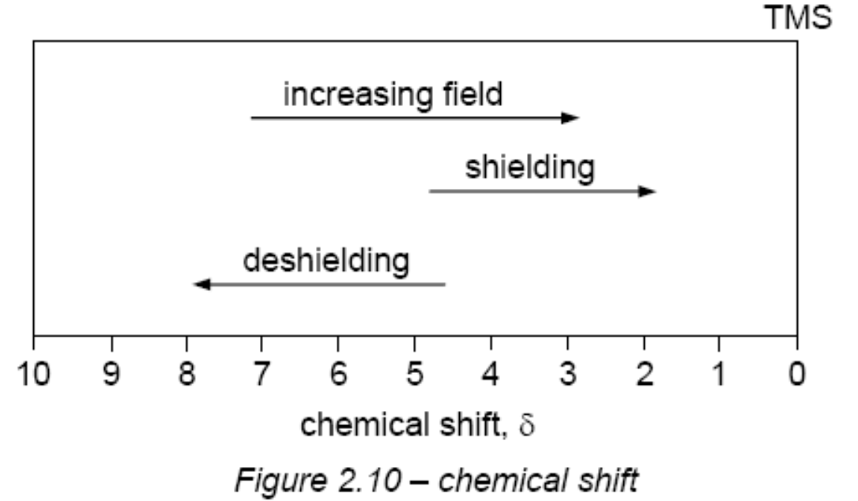
Chemical Shift
Most protons in organic molecules resonate within 10 ppm of TMS, and by convention, the zero point of the scale (TMS) is on the right hand side (Figure 2.10).

Slide 18
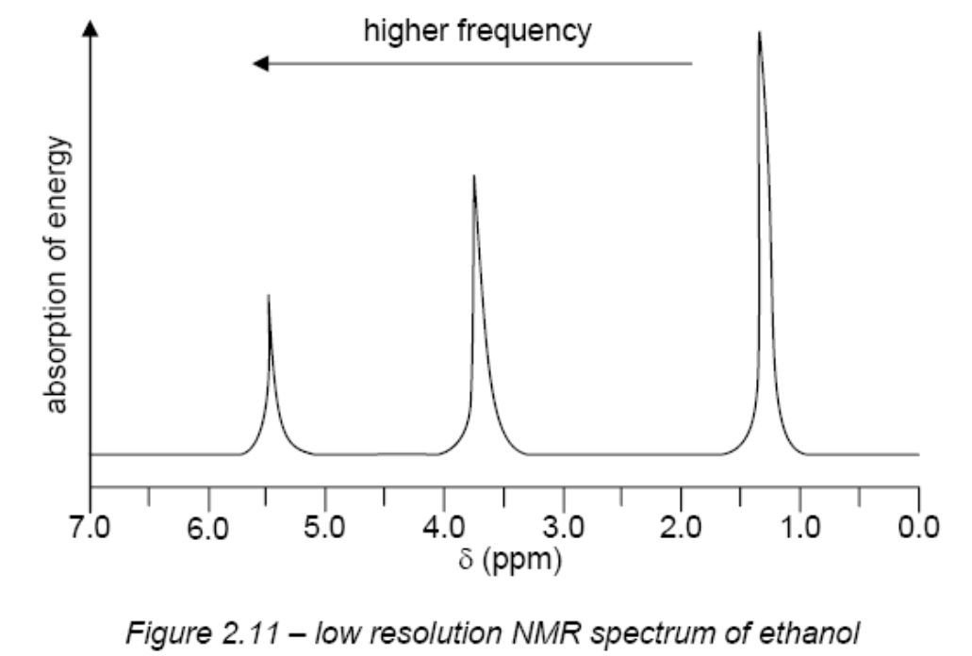
The ¹H NMR spectra of ethanol
The low resolution NMR spectrum of ethanol contains three different absorption peaks occurring at slightly different values of the applied field
These different peaks are explained by assuming that the single -OH proton, the two -CH₂- protons and the three -CH₃ protons all resonate at slightly different values of applied field
The nearer a proton is to the electronegative oxygen atom, the less shielded it is from the external magnetic field. (Oxygen atom attracts the bonding electrons, and their diamagnetic effect on the resonating proton is reduced.)

Slide 19
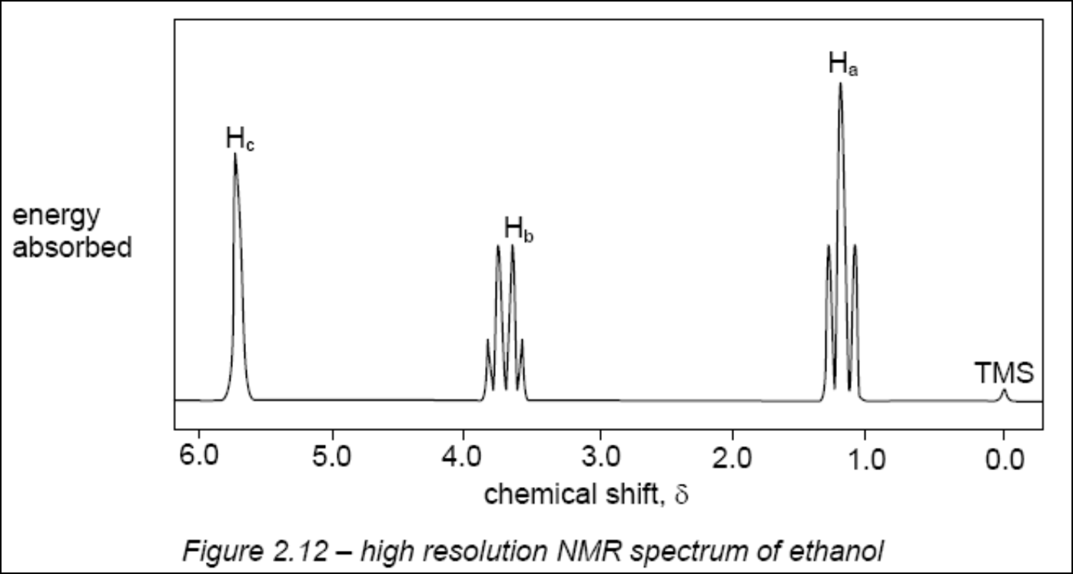
The ¹H NMR spectra of ethanol
High-resolution spectrum of ethanol (see Figure 2.12) shows the same three peaks,
The peak at δ 1.2 is split into three peaks,
and that at δ 3.7 is split into four.
This is due to a phenomenon known as spin-spin coupling.

Slide 20
Chemical Shift
The local magnetic field experienced by a resonating proton is not only influenced by the presence of the electrons in the bonds around it, but is also influenced by the orientation of the magnetic moments of nearby protons.
If the magnetic moment of a nearby proton is aligned with the external field, the local magnetic field experienced by the resonating proton will be increased.

Slide 21
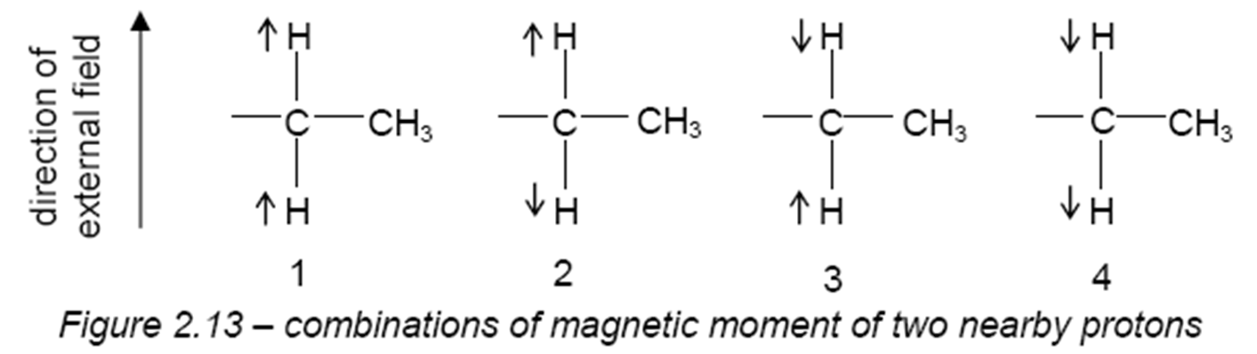
The ¹H NMR spectra of ethanol
The resonating proton will therefore absorb energy at two different frequencies.
Because the populations of the two energy levels (+ ½ and – ½ ) are almost equal, the absorbances at the two frequencies of the resonating proton will be equal, and a doublet of lines will be seen.
More complicated if there are two nearby protons.
The magnetic moment of each proton can be either with or against the field.

Slide 22
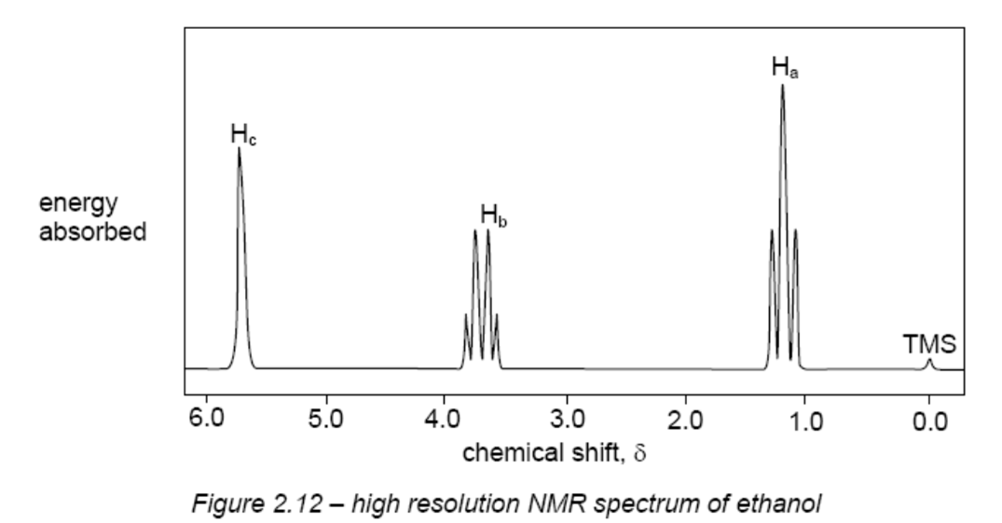
The ¹H NMR spectra of ethanol
2 and 3; the magnetic moments of the two -CH₂- proton cancel each other out, so the field experienced by the -CH₃ protons will not change.
1 and 4; the magnetic moments of the - CH₂- protons reinforce each other, and so the field experienced by the - CH₃ protons will be higher or lower.
-CH₃ protons to absorb at three different frequencies.
Forming a 1:2:1 triplet of lines.
This is exactly what is observed for the absorption centred on δ 1.2.

Slide 23
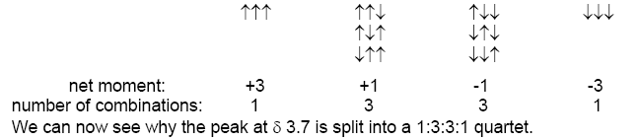
The ¹H NMR spectra of ethanol
splitting pattern of the peak at δ 3.7
the magnetic moments of the three protons in the -CH₃ group can be oriented in the following combinations:

Slide 24
The ¹H NMR spectra of ethanol
The general rules governing splitting patterns are as follows:
1. Protons in identical chemical environments (e.g. the three H atoms in the -CH₃ group) do not split their own absorption peak.
2. The absorption peak of resonating protons is only split by nearby protons on the adjacent carbon atom – protons further away (usually) have little effect.
3. The absorption of protons adjacent to n protons is split into (n + 1) peaks.

Slide 25
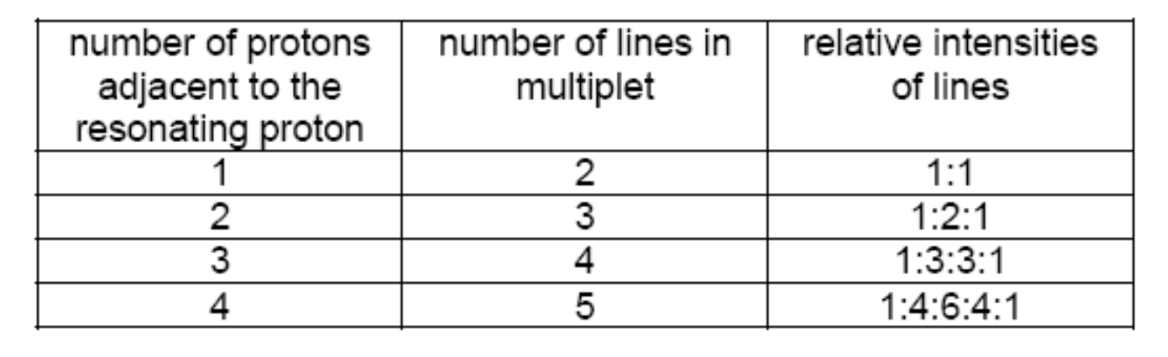
The ¹H NMR spectra of ethanol
The intensities of the peaks in a multiplet are as in the following table.

Slide 26
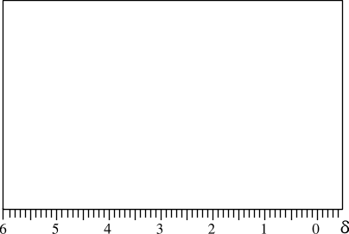
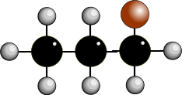
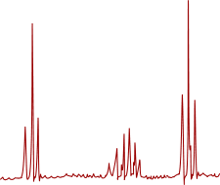

LOW RESOLUTION - HIGH RESOLUTION
low resolution nmr gives 1 peak for each environmentally different group of protons
high resolution gives more complex signals - doublets, triplets, quartets, multiplets
the signal produced indicates the number of protons on adjacent carbon atoms
HIGH RESOLUTION SPECTRUM OF 1-BROMOPROPANE
The broad peaks are split into sharper signals
The splitting pattern depends on the number of hydrogen atoms on adjacent atoms

Slide 27
MULTIPLICITY (Spin-spin splitting)
high resolution gives more complex signals - doublets, triplets, quartets, multiplets
the signal produced indicates the number of protons on adjacent carbon atoms
Number of peaks = number of chemically different H’s on adjacent atoms (n) + 1
1 neighbouring H 2 peaks “doublet” 1:1
2 neighbouring H’s 3 peaks “triplet” 1:2:1
3 neighbouring H’s 4 peaks “quartet” 1:3:3:1
4 neighbouring H’s 5 peaks “quintet” 1:4:6:4:1
Signals for the H in an O-H bond are unaffected by hydrogens on adjacent atoms - get a singlet

Slide 28
MULTIPLICITY (Spin-spin splitting)
Number of peaks = number of chemically different H’s on adjacent atoms + 1
0 neighbouring H’s signal isn’t split 1 peak “singlet”
1 neighbouring H signal split into 2 peaks “doublet” ratio 1:1
2 neighbouring H’s 3 peaks “triplet” 1:2:1
3 neighbouring H’s 4 peaks “quartet” 1:3:3:1
4 neighbouring H’s 5 peaks “quintet” 1:4:6:4:1

Slide 29
MULTIPLICITY (Spin-spin splitting)
PASCAL’S TRIANGLE
It is interesting to note the relationship between the successive peak ratios. It follows the pattern found in Pascal’s triangle.
Each number in the series is the sum of the two numbers above it in the triangle
What would be the pattern for 6 neighbouring hydrogens?
1
1 1
1 2 1
1 3 3 1
1 4 6 4 1
1 5 10 10 5 1
1 6 15 20 15 6 1
PRESS THE SPACE BAR FOR THE ANSWER

Slide 30
MULTIPLICITY (Spin-spin splitting)
Splitting patterns are worked out by considering the effect adjacent, chemically different protons have on another signal in a given environment.
The spin of the proton producing the signal is affected by each of the two forms of the adjacent proton.
One orientation augments/enhances its field and the other opposes/reduces it. This is done by calculating the various possible combinations of alignment of adjacent protons.
HOWEVER
Signals for the H in an O-H bond are not affected by hydrogens on adjacent atoms so are not split.

Slide 31
MULTIPLICITY (Spin-spin splitting)
ANALOGY
Imagine you had an opinion on something. If nobody influenced you, your opinion would be the same. However if another person had a view on the topic, they would either agree or disagree with you. Their ideas would either enhance what you thought or diminish it. There would be two possibilities of equal chance.
If there were two people offering views they could either be both for it (1 possibility) , both against (1 possibility) or one could be in favour and the other against (2 possibilities). There would be three possibilities of relative chance 1:2:1
FOR AGAINST

Slide 32
MULTIPLICITY (Spin-spin splitting)
O adjacent H’s
There is no effect
1 adjacent H
can be aligned either with a or against b the field
there are only two equally probable possibilities
the signal is split into 2 peaks of equal intensity
2 adjacent H’s
more possible combinations
get 3 peaks in the ratio 1 : 2 : 1
3 adjacent H’s
even more possible combinations
get 4 peaks in the ratio 1 : 3 : 3 : 1
EXPLAIN THE THEORY BEHIND THE SPLITTING PATTERN FOR 4 ADJACENT H’s

Slide 33
MULTIPLICITY (Spin-spin splitting)
4 adjacent H’s
gives 5 peaks in the ratio 1 : 4 : 6 : 4 : 1

Slide 34
The ¹H NMR spectra of ethanol
You may have noticed that the peak in Figure 2.12 due to the –OH proton is a singlet
This splitting does not occur because protons on –OH groups undergo rapid exchange with each other, and with protons on other –OH groups such as those in water.
CH₃CH₂OH + H₂O ⇌ CH₃CH₂OH + HOH
(The –OH absorption in ultra-dry ethanol does in fact appear as a triplet).

Slide 35
The ¹H NMR spectra of ethanol
A useful application of this ready exchange of –OH protons is the disappearance of their absorption peak when an NMR sample is shaken with D₂O (D is deuterium, ²H).
CH₃CH₂OH + D₂O ⇌ CH₃CH₂OD + HOD
The area under each peak is proportional to the number of protons responsible for that absorption. Thus from the left hand side, the areas of the peaks are in the ratio 1:2:3.
This is also true for the high-resolution spectrum in Figure 2.12.
This information is usually presented on the spectrum either as an integration trace or as the indication nH printed near the peak, where n is the number of protons (see Figure 2.12).

Slide 36

The ¹H NMR spectra of ethanol

Slide 37
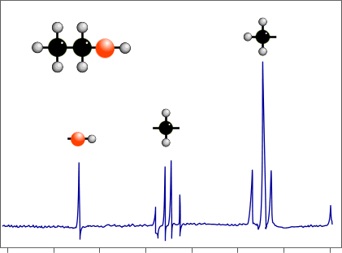
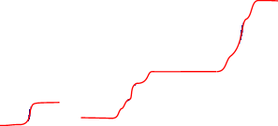
INTEGRATION
The area under a signal is proportional to the number of hydrogen atoms present
An integration device scans the area under the peaks
Lines on the spectrum show the relative abundance of each hydrogen type
By measuring the distances between the integration lines one can
Work out the simple ratio between the various types of hydrogen.
before integration after integration
NOTICE THAT THE O-H SIGNAL IS ONLY A SINGLET

Slide 38
INTEGRATION
Measure the distance between the top and bottom lines.
Compare the heights from each signal and make them into a simple ratio.
HOW TO WORK OUT THE SIMPLE RATIOS
Measure how much each integration line rises as it goes of a set of signals
Compare the relative values and work out the simple ratio between them
In the above spectrum the rises are in the ratio... 1:2:3
IMPORTANT: It doesn’t provide the actual number of H’s in each environment, just the ratio

Slide 39
O-H bonds and splitting patterns
The signal due to the hydroxyl (OH) hydrogen is a singlet ... there is no splitting
H’s on OH groups do not couple with adjacent hydrogen atoms
Arises because the H on the OH, rapidly exchanges with protons on other molecules and is not attached to any particular oxygen long enough to register a splitting signal.
OH hydrogens are always seen as a singlet ... there is no splitting
This is a quartet despite the fact that there are 4 H’s on adjacent atoms - the H on the OH doesn’t couple

Slide 40

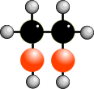
NMR SPECTROSCOPY
When is a hydrogen chemically different?
TWO SIGNALS
Quartet and triplet :- ratio of peak areas = 3 : 2
Carbons 1 & 4 are the similar and so are carbons 2 & 3 so there are only two different chemical environments.
The signal for H’s on carbon 2 is a quartet - you ignore the two neighbours on carbon 3 because they are chemically identical.
TWO SIGNALS
both singlets :- ratio of peak areas = 2 : 1
Hydrogens on OH groups only give singlets. The signal for H’s on each carbon are not split, because
- H’s on the neighbouring carbon are chemically
identical... and
- H’s on adjacent OH groups do not couple.
1
2
3
4
BUTANE
ETHANE-1,2-DIOL

Slide 41
NMR SPECTROSCOPY - SUMMARY
An NMR spectrum provides several types of information :-
Number of signals | The number of different proton environments
Chemical shifts | The general environment of the protons
Peak area (integration) | The number of protons in each environment
Multiplicity | How many protons are on adjacent atoms
In many cases this information is sufficient to deduce the structure of an organic molecule but other forms of spectroscopy are used in conjunction with nmr.

Slide 42
NMR SPECTROSCOPY
“CENSUS” QUESTIONS
- describe where each hydrogen lives
- say how many hydrogens live on that atom
- say how many chemically different hydrogen
atoms live on adjacent atoms
1
2
3
1-BROMOPROPANE
ATOM
UNIQUE DESCRIPTION OF THE POSITION OF THE HYDROGEN ATOMS
H’S ON THE ATOM
CHEMICALLY DIFFERENT H’S ON ADJACENT ATOMS
SIGNAL SPLIT INTO
1
On an end carbon, two away from the carbon with the bromine atom on it
3
2
2+1 = 3
2
On a carbon atom second from the end and one away from the carbon with the bromine atom
2
3+2 = 5
5+1 = 6
3
On an end carbon atom which also has the bromine atom on it
2
2
2+1 = 3

Slide 43
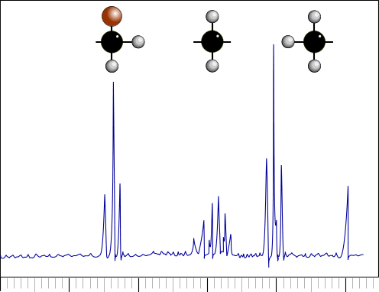
Spectrum of 1-bromopropane
CHEMICAL SHIFTS
3 environments = 3 signals
Triplet d = 3.4
Sextet d = 1.9
Triplet d = 1.0
Signal for H’s on carbon 3 is shifted furthest downfield from TMS due to proximity of the electronegative halogen
1
2
3
TMS
5 4 3 2 1 0 δ

Slide 44

Spectrum of 1-bromopropane
INTEGRATION
Area ratio from relative heights of integration lines = 2 : 2 : 3
Carbon 1 3
Carbon 2 2
Carbon 3 2
1
2
3
2
3
TMS
2
5 4 3 2 1 0 δ

Slide 45
Spectrum of 1-bromopropane
SPLITTING
SPLITTING PATTERN
Carbon 1
Chemically different hydrogen atoms on adjacent atoms = 2
2 + 1 = 3
The signal will be a
TRIPLET
1
1
2
3
TMS
5 4 3 2 1 0 δ

Slide 46
Spectrum of 1-bromopropane
SPLITTING
SPLITTING PATTERN
Carbon 2
Chemically different hydrogen atoms on adjacent atoms = 5
5 + 1 = 6
The signal will be a
SEXTET
2
1
2
3
TMS
5 4 3 2 1 0 δ

Slide 47
Spectrum of 1-bromopropane
SPLITTING
SPLITTING PATTERN
Carbon 3
Chemically different hydrogen atoms on adjacent atoms = 2
2 + 1 = 3
The signal will be a
TRIPLET
3
1
2
3
TMS
5 4 3 2 1 0 δ
The signal is shifted furthest away (downfield) from TMS as the hydrogen atoms are nearest the electronegative bromine atom.

Slide 48
Spectrum of 1-bromopropane
SPLITTING
3 environments = 3 signals
1 Triplet d = 1.0 3 H’s
2 Sextet d = 1.9 2 H’s
3 Triplet d = 3.4 2 H’s
Signal for H’s on carbon 3 is shifted furthest downfield from TMS due to proximity of the electronegative halogen
3
2
1
1
2
3
TMS
5 4 3 2 1 0 δ

Slide 49
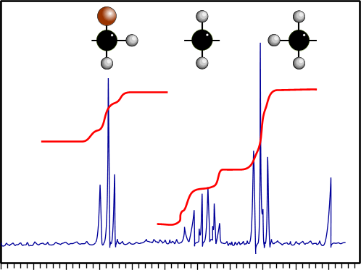
Spectrum of 1-bromopropane
1
2
3
TMS
4 3 2 1 0 δ
SUMMARY
Peaks Three different signals as there are three chemically different protons.
Shift Signals are shifted away from TMS signal, are nearer to the halogen.
Splitting Signals include a triplet (d = 1.0) sextet (d = 1.8) triplet (d = 3.4)
Integration The integration lines show that the ratio of protons is 2:2:3
The signals due to the protons attached to carbon ...
C1 triplet (d = 1.0) coupled to the two protons on carbon C2 ( 2+1 = 3 )
C2 sextet (d = 1.8) coupled to five protons on carbons C1 and C3 ( 5+1 = 6 )
C3 triplet (d = 3.4) coupled to the two protons on carbon C2 ( 2+1 = 3 )

Slide 50
Magnetic Resonance Imaging (MRI)
A patient is placed on a steady table and the part of the body to be scanned (often the head) is immobilised.
The table is slowly passed through the magnetic field, where a fine beam of UHF radiation is passed through and analysed.
This shows the ¹H absorption pattern of a thin section (about 1 cm thick) of the body.
The table continues to move gently into the magnetic field, and after each 1 cm another absorption pattern is recorded.
A typical brain scan containing 20-30 slices takes only 10 minutes to complete.

Slide 51
Magnetic Resonance Imaging (MRI)
Most of the hydrogen atoms within cells are in water molecules or lipid molecules, and it is the environment of the water molecules that gives an indication of the medical state of the cell.
MRI is useful in pinpointing brain tumours and sites of injury, and diagnosing hydrocephalus, multiple sclerosis, Alzheimer’s and other brain diseases.

Slide 52
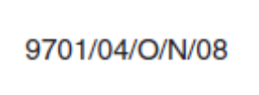
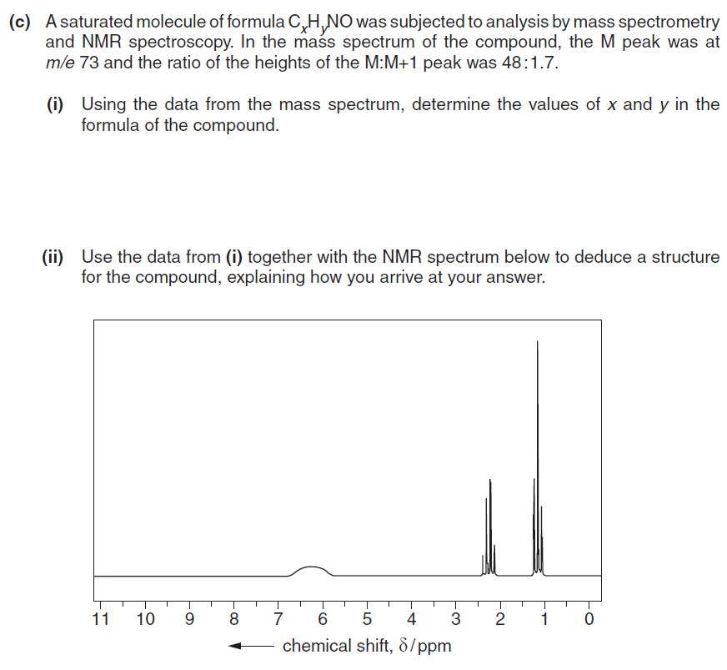
Past Year Questions

Slide 53
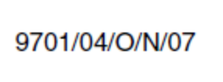
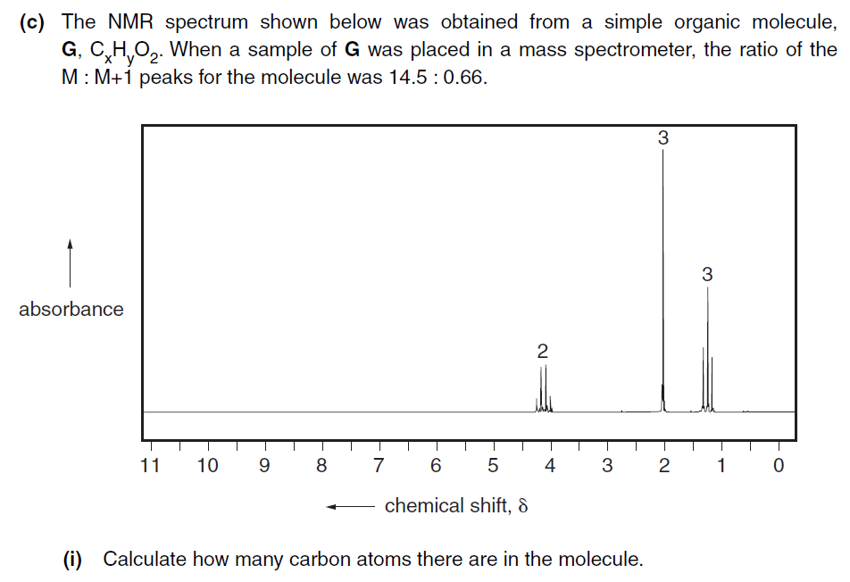
Past Year Questions

